Slide 1
Expectation Maximization
Dr.Srinivas Battula
Associate Professor
VIT-AP University

Slide 2
Expectation Maximization
EM algorithm provides a general approach to learning in presence of unobserved variables.
In many practical learning settings, only a subset of relevant features or variables might be observable. – Eg: Hidden Markov, Bayesian Belief Networks
Estimation: Estimate the expectation from some random data
Maximization: Whatever is estimated should be maximized to find the best result.
From given data EM learn a theory which tells that how each example to be classified and how to predict the feature value of each class.

Slide 3
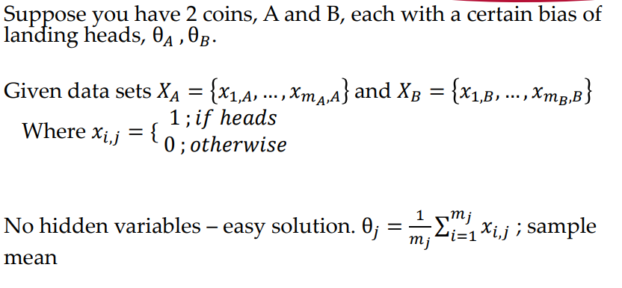
Expectation Maximization

Slide 4
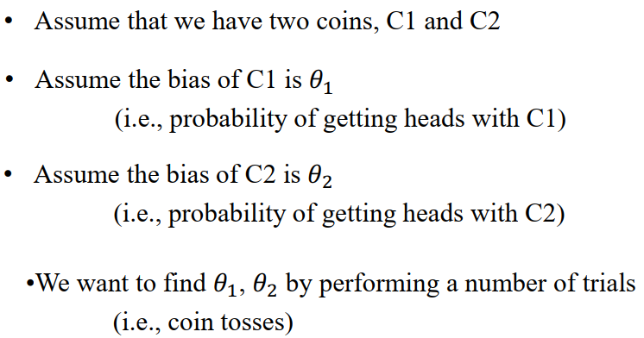
Example

Slide 5
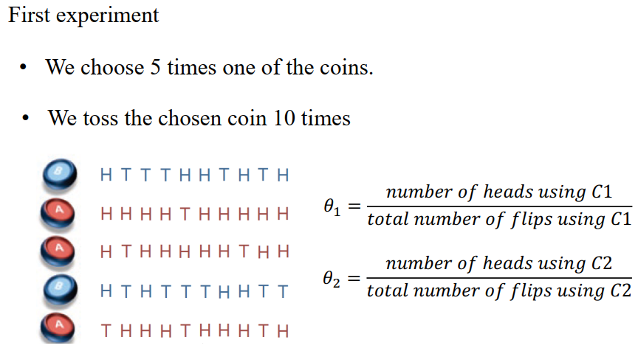
Example

Slide 6
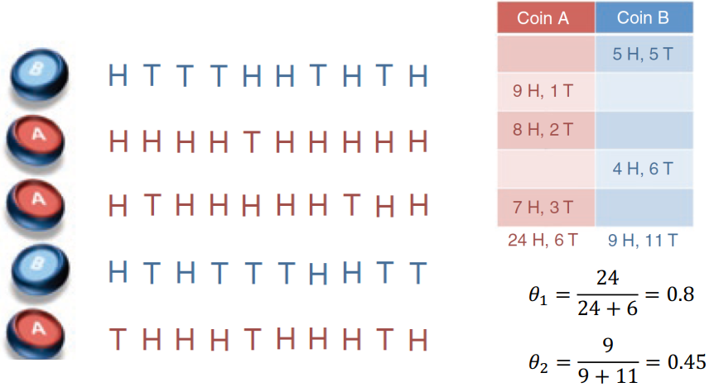
Maximum likelyhood:

Slide 7
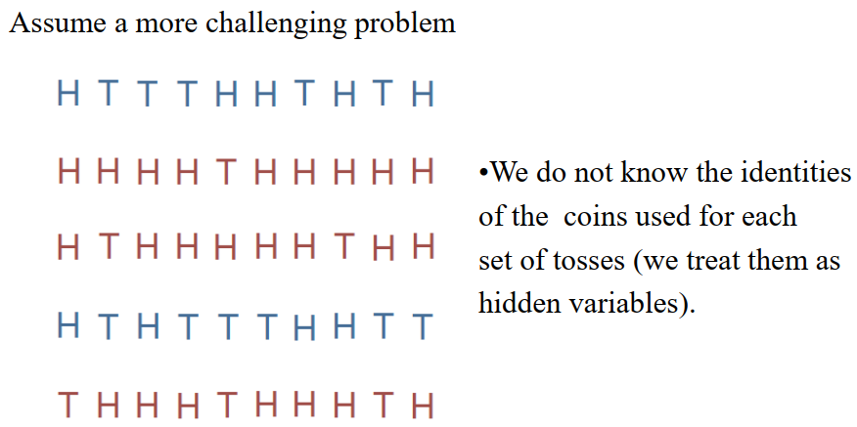
Example with Hidden Variable

Slide 8
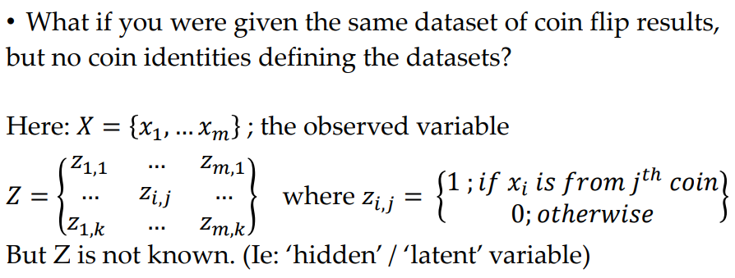
Example with Hidden Variable

Slide 9
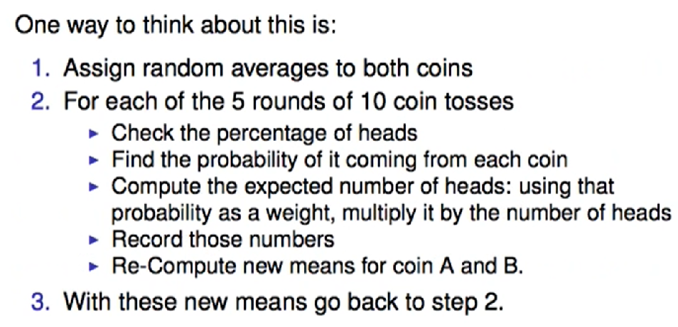
EM Algorithm

Slide 10
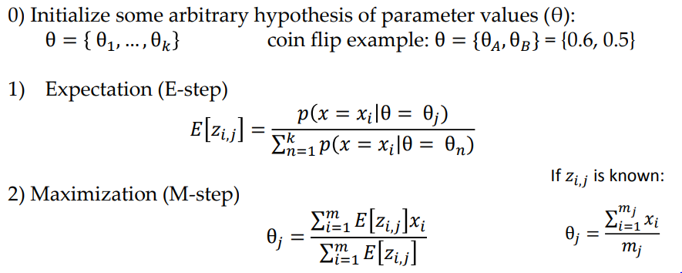
Example with Hidden Variable

Slide 11
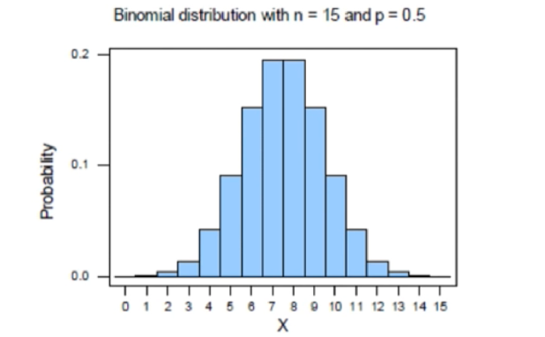
How do Coin Tosses Behave

Slide 12
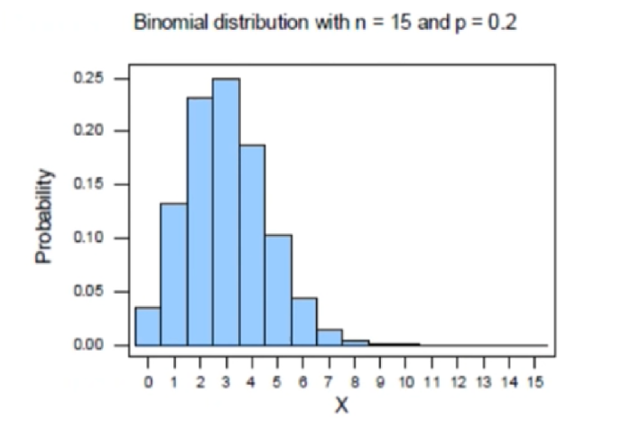

Slide 13

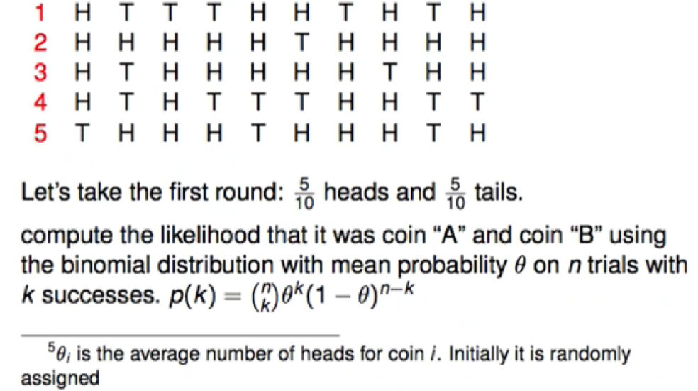
EM Algorithm: Example The 5 rounds of 10 coin tosses with 0.5

Slide 14
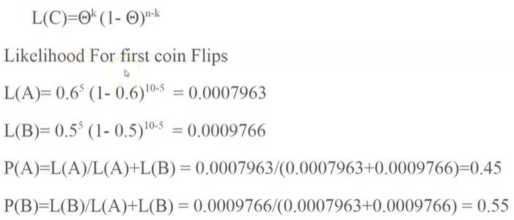
Example with Hidden Variable

Slide 15
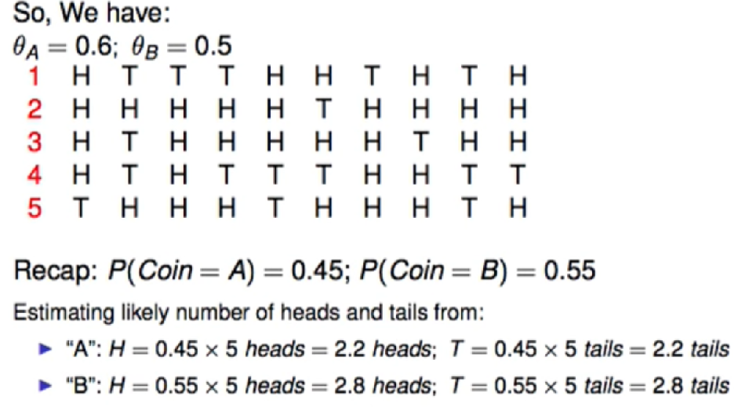
EM Algorithm: M-Step

Slide 16
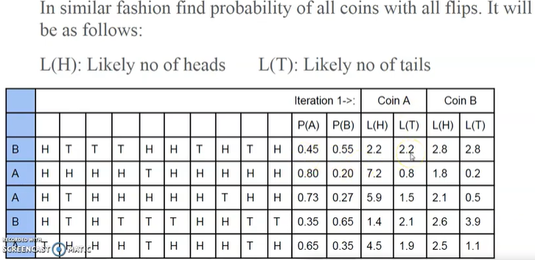
Example with Hidden Variable

Slide 17
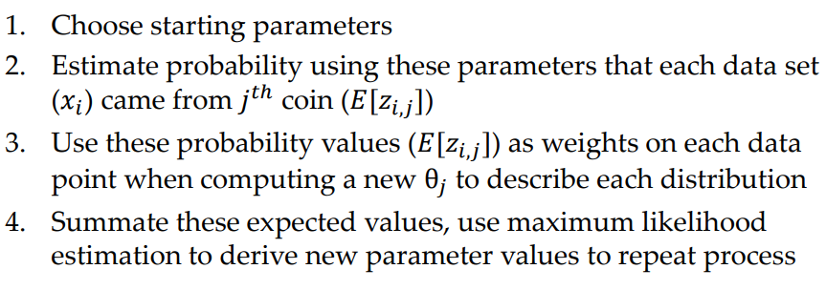
Expectation Maximization

Slide 18
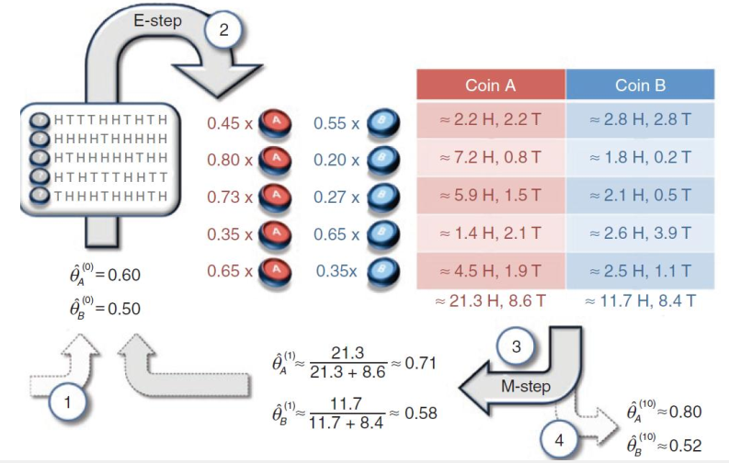

Example with Hidden Variable

